Slide 1


Data
Analysis

Slide 2


Today's agenda
Project recap
Problem
The Analytics team
Process
Insights
Summary

Slide 3

Social Buzz is a fast growing tech company who needs our assistance now, so we started a 3 month initial project in order to help them with the following tasks:
- An audit of their big data practice
- Recommendations for a successful IPO
- An analysis of their content categories that are the top 5 in popularity
Project Recap

Slide 4


Problem
Everyday over 100,000 pieces of content, ranging from
texts, images, gif and videos are posted.
Approximately 3,000,000 pieces of content per month are posted.
Company feels its too much data to handle by themselves

Slide 5



ANDREW FLEMING
Chief Technology Architect
The Analytics team
MARCUS ROMPTON
Senior Principal
Yuvan Kalyan
Data Analyst

Slide 6
Process
1
Understanding the dataset
2
Data Cleaning
3
Data Modelling
4
Data Analysis
5
Insights

Slide 7

Insights
58.87%
16
Animals
Positive Reactions
Categories of posts
Category with most scores

Slide 8
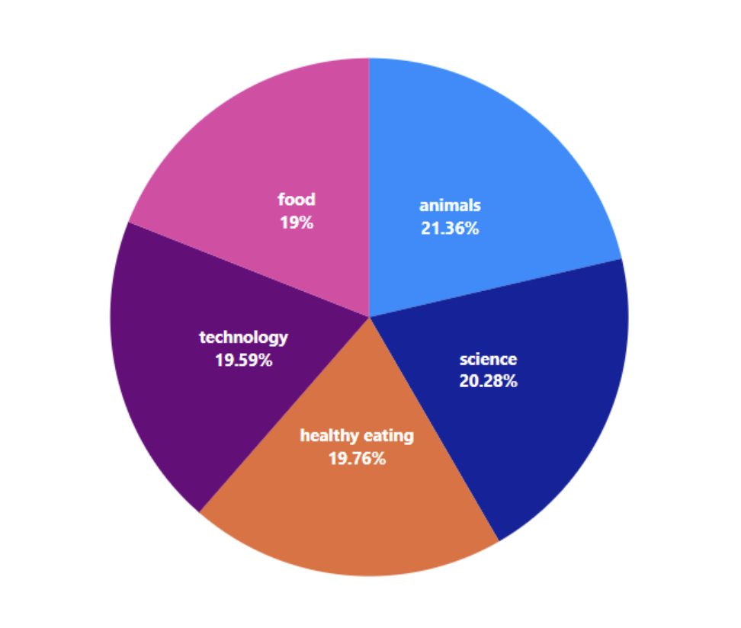
Popularity % of top 5 categories
Animas and Science are the most popular categories

Slide 9
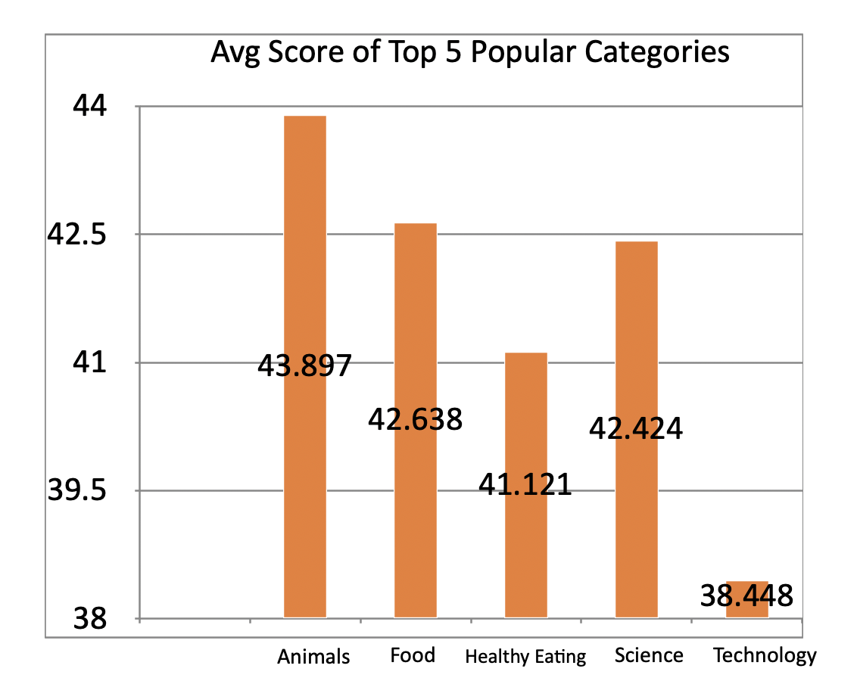

Slide 10

ANALYSIS
Animals and Food are two most popular categories of content, showing that people enjoy ‘real-life’ and ‘tasty’ content the most.
INSIGHT
Food is the common theme with the top 5 categories with ‘Healthy Eating’ ranking the highest. This may give an indication to the audience within your user base. You could use this insight to create a campaign and work with healthy eating brands to boost user engagement.
Summary
NEXT STEPS
This ad-hoc analysis is insightful, but it’s time to take this analysis into large scale production for real-time understanding of your business. We can show you how to do this.

Slide 11

Thank you!
ANY QUESTIONS?

